Slide 1

Documentation Review
Tod Hilton

Slide 2
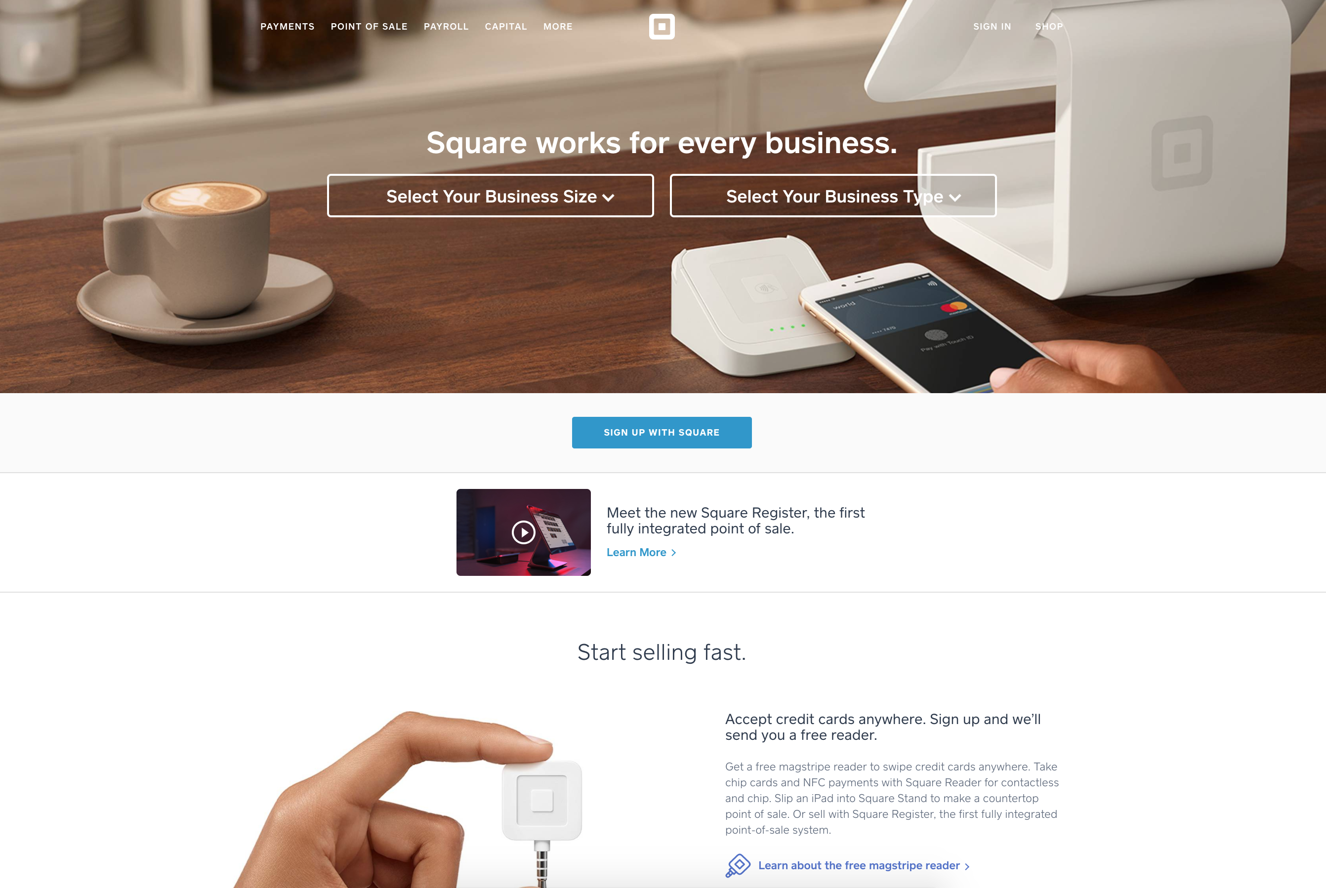
Notes:
A developer starting with the home page, https://squareup.com.
Homepage
Things I like:
Clean, modern user interface.
Nice usage of whitespace, images, and font selection.
End user products are highlighted and described succinctly.

Slide 3
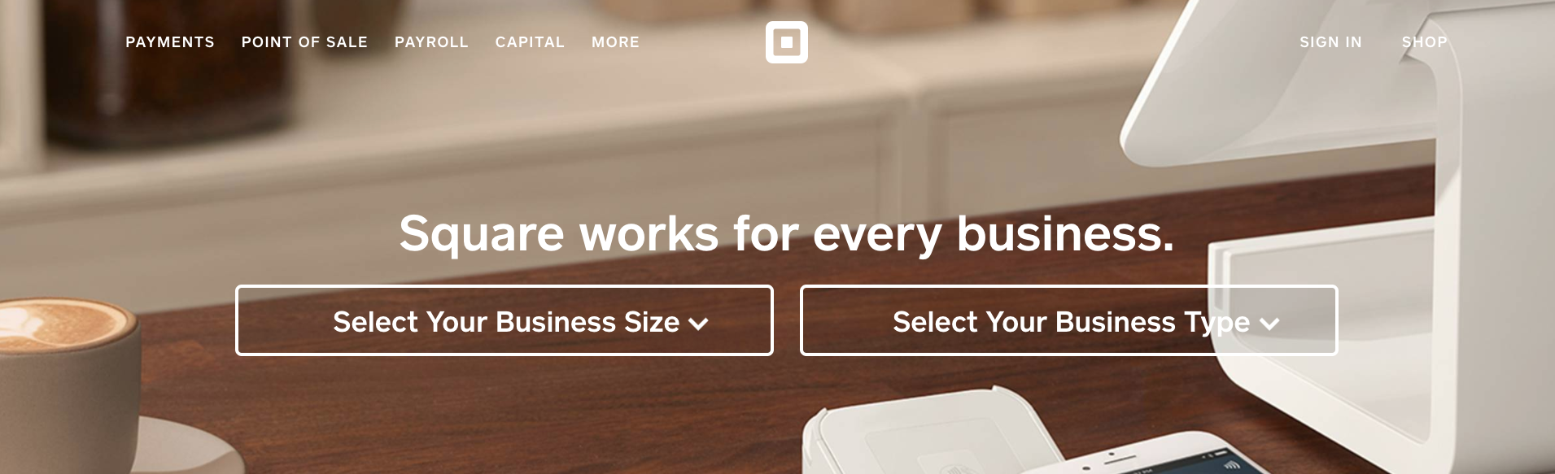
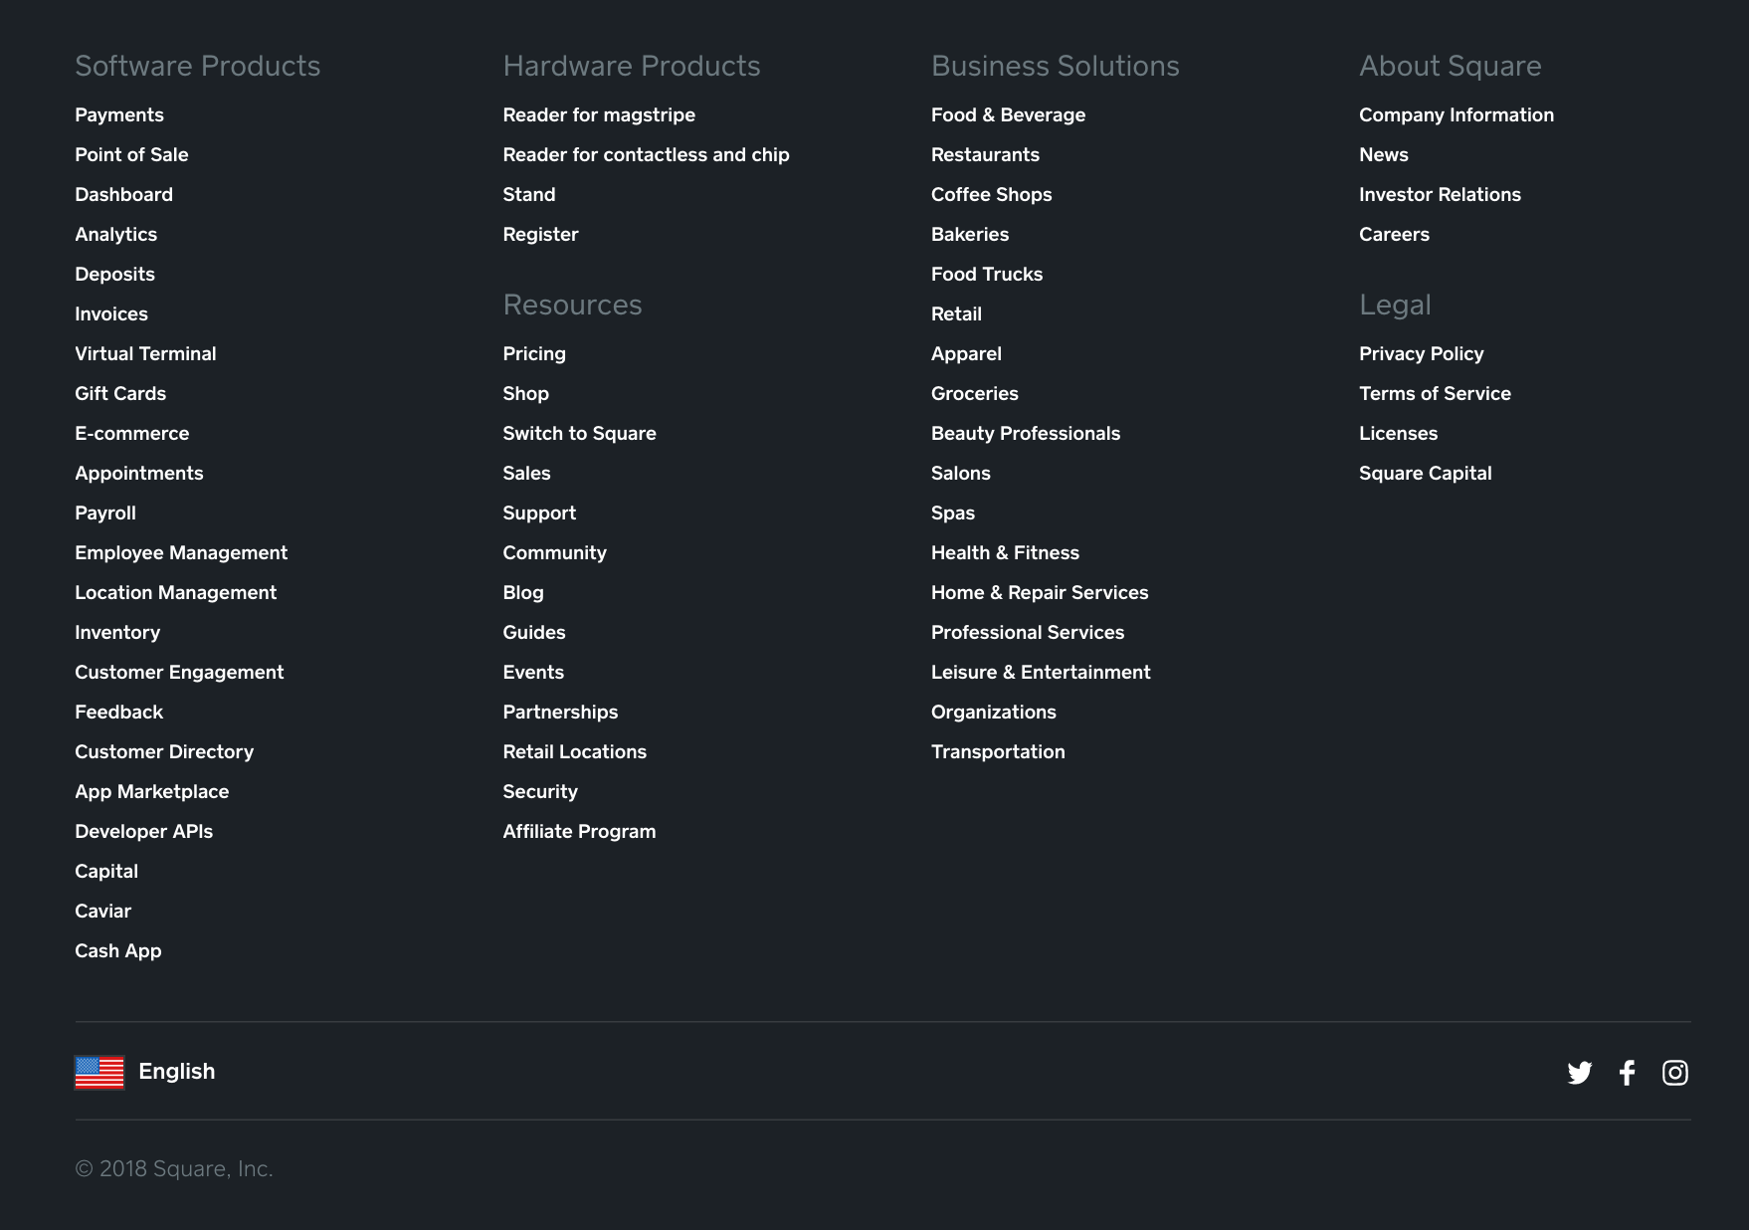
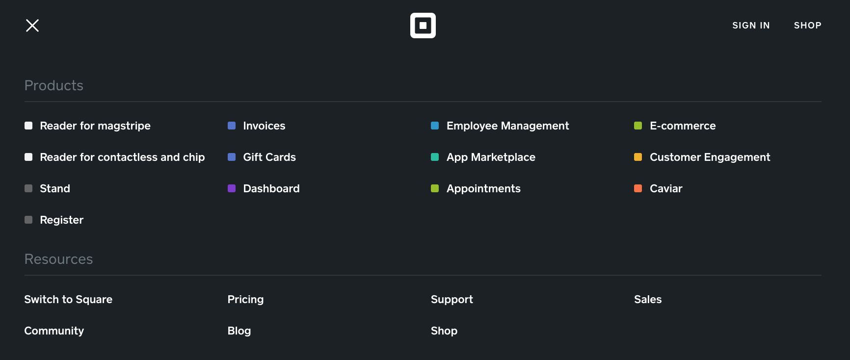
Default Top Menu
?
Bottom Menu
Top More Menu
?
Developers
look here!
Notes:
Landing page: https://squareup.com
Homepage
What could be improved:
Add a search button/magnifying glass.
Advertise the developer platforms.
Promote the link for developers and make it more obvious, maybe even give the developer platform it’s own section as you’re scrolling. It’s buried at the bottom of the page in small text.
Best practices:
Make things easy to find and discoverable.

Slide 4
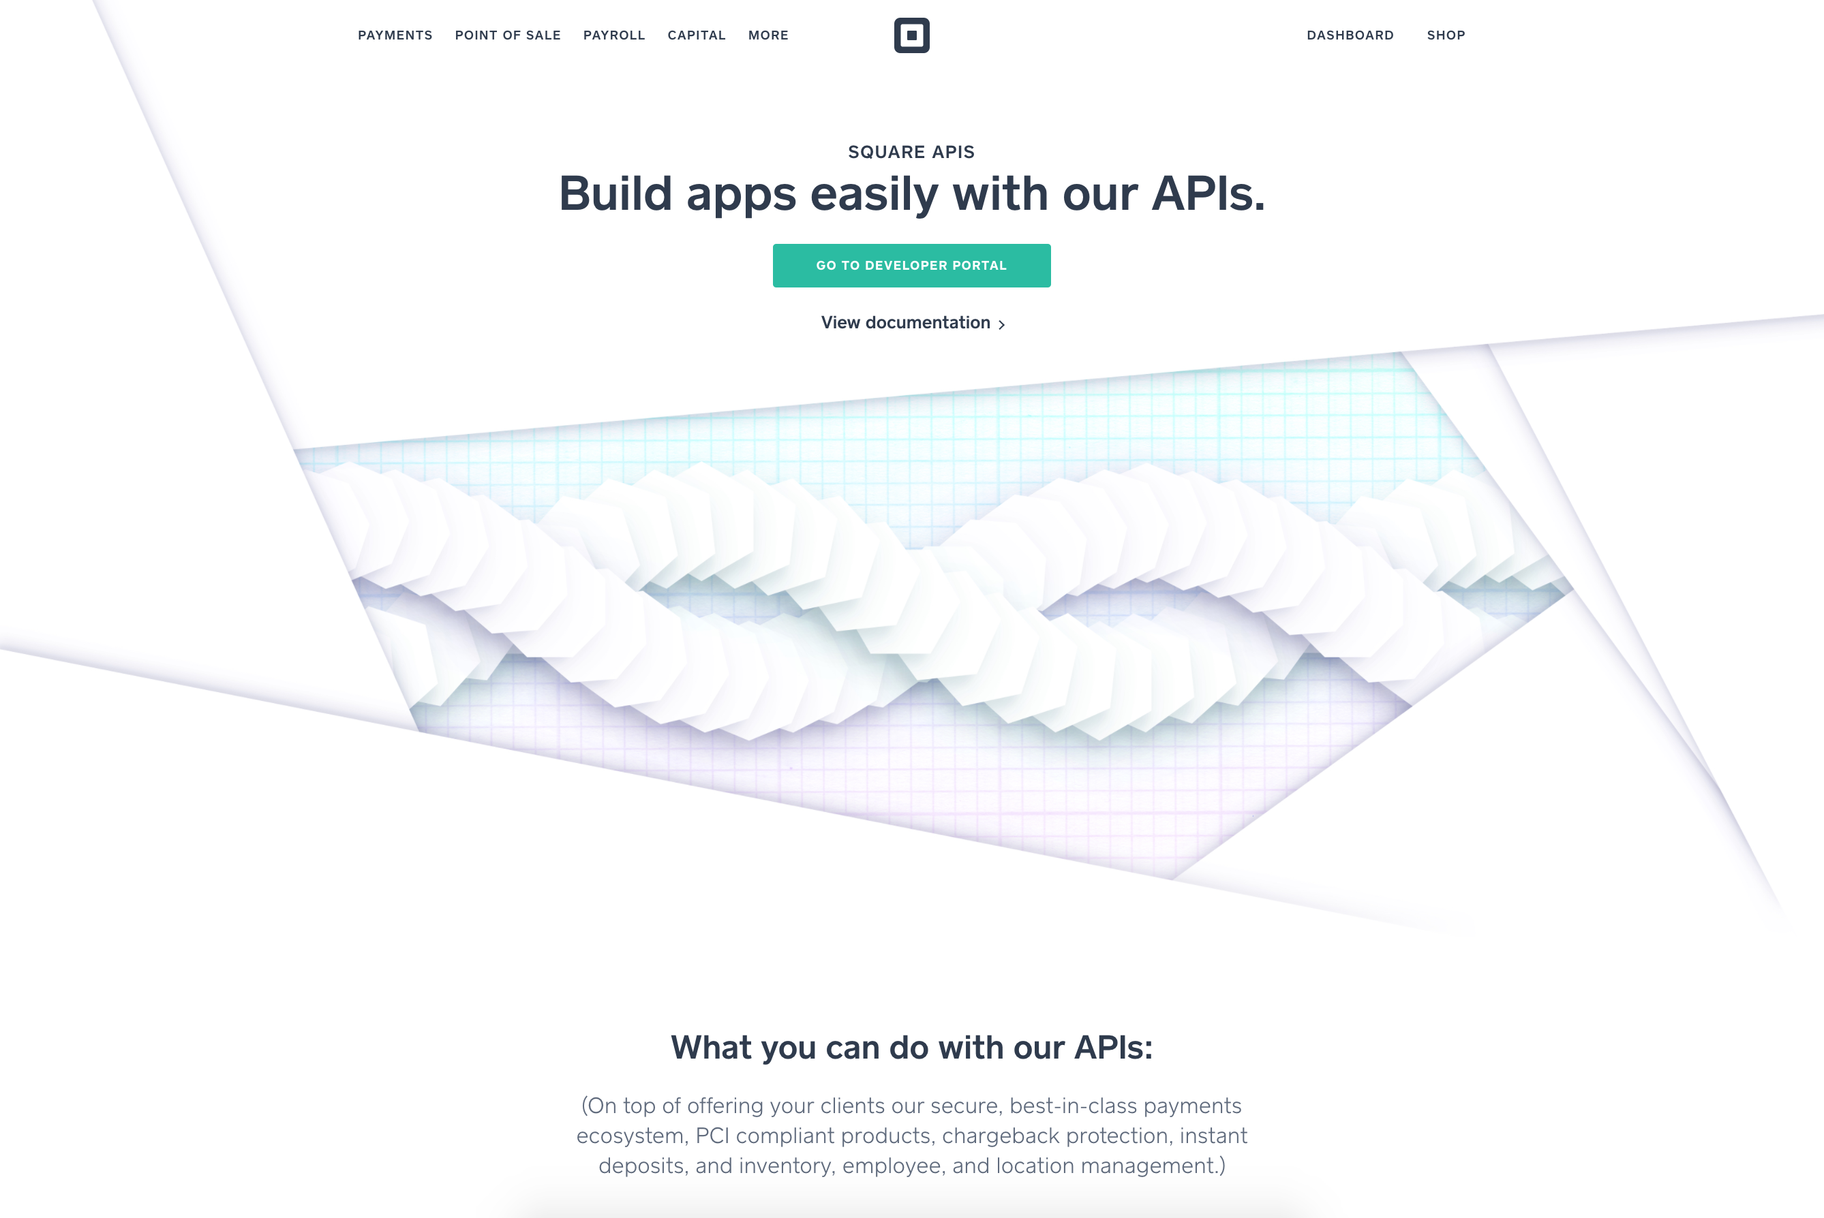
Notes:
Developer selects link to Developer APIs from homepage.
Landing page: https://squareup.com/developers
Developers
Things I like:
Clean, modern user interface.
The top navigation bar remains the same as the homepage.
Nice usage of whitespace, images, and font selection.
Clearly placed link to View documentation at the top of the page.
What could be improved:
Add functionality to search the documents straight from this page.
Change the page title from “SQUARE APIS” to “SQUARE DEVELOPERS” to match the URL (https://squareup.com/developers) since this is about more than just APIs.
Change the View the APIs link to take the user to a succinct description of the multiple APIs available so they can select the appropriate one (instead of the Connect V2 APIs, but what if they're looking for Oauth or Point-of-Sale SDKs).
Increase the visibility of the link to blog posts on Medium.
Create a ToC of the blog posts on this page or somewhere on the docs site for easy reference.
Best Practices:
Make things easy to find and discoverable.

Slide 5
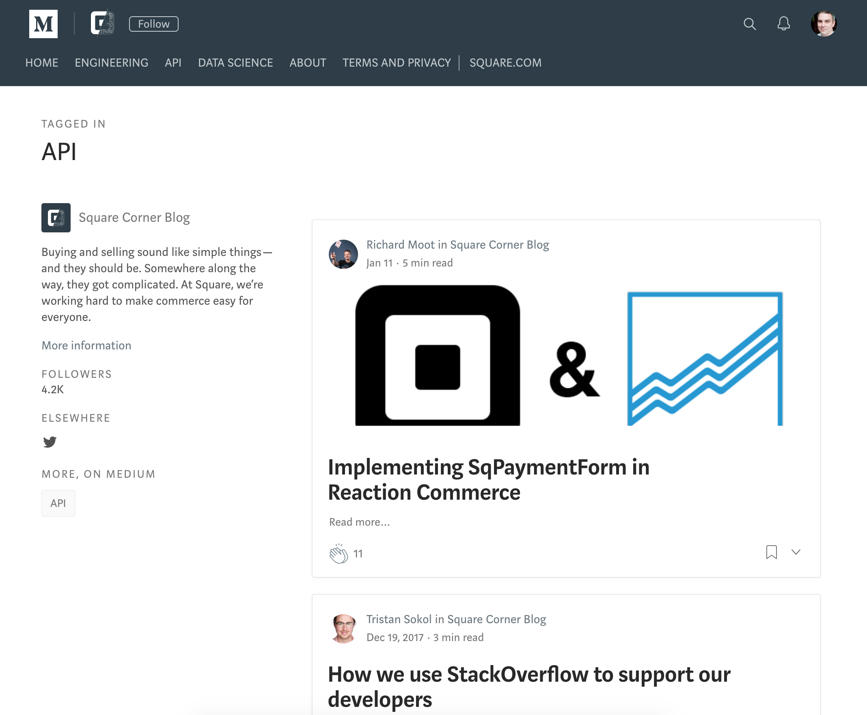
Notes:
Developer detours to the blog site linked from the Square APIs page.
Landing page: https://medium.com/square-corner-blog/tagged/api
Blog
Things I like:
Increasing visibility of the posts
Provides several end-to-end scenarios
All the positives that go along with using Medium: increased interaction with users, improved visibility, simple process for posting, they manage the platform
Things to change:
Put them in the standard doc location. Then write about them on Medium and link the user back to our doc site.
Could also copy/paste the content so that it's the exact same in each location.
Best practices:
Own your docs, just like your code. Using Medium is great for visibility, but you put ownership in someone else’s hands (like any social media platform).

Slide 6
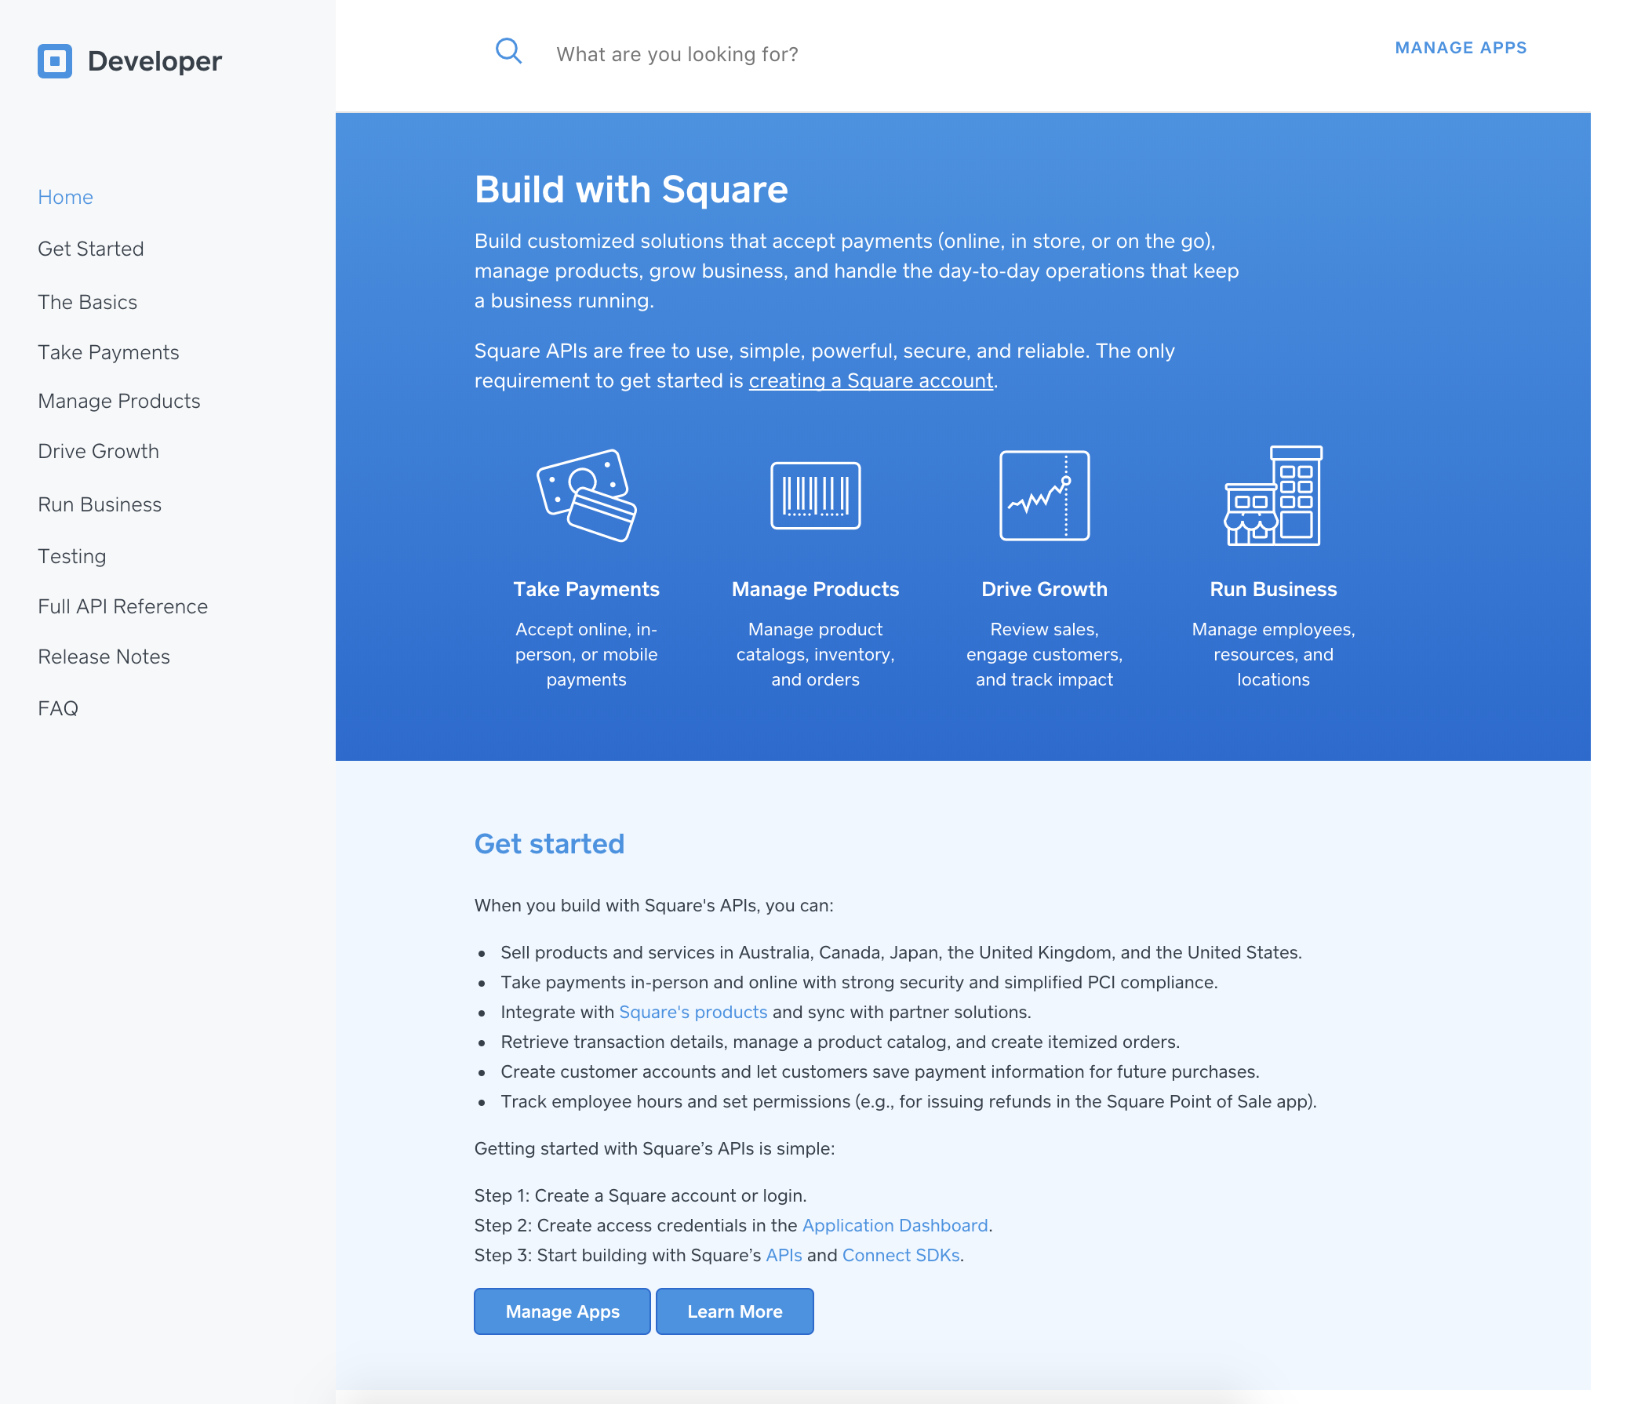
Notes:
Developer selects the link to View documentation from the Square APIs page (https://squareup.com/developers).
Landing page: https://docs.connect.squareup.com/
Doc site – DESIGN
Things I like:
Clean, modern look and feel. Lot of whitespace. Pleasant color scheme.
Site works well when resized and viewed on mobile/smaller devices.
Search functionality is present.
Expandable table of contents is simple and intuitive. It clearly states high-level areas of organization. Also allows drilling down into sub-categories.
A quick link in the ToC to the full list of API references (with expandable selection of specific ones).
Nice that there are easy ways to get in touch with the Square team via Stack Overflow and Slack and, more importantly, that the Square team is responsive.
Client libraries and SDK source code is accessible on GitHub and linked to from the Client libraries page.
Some of the GitHub repos allow users to file issues and employees respond in a timely manner.
The smiley face feedback (“was this page helpful”) is simple and easy for users to provide quick feedback.
Things to change:
Update the top nav bar to match the home page design (images & links). It's a noticeably different design.
Promote the blog on Medium throughout the doc site as having end-to-end scenarios, perhaps with a sticky link in the header/footer that says more than just "blog."
Clarify where users are in the bigger context of the site's organization, such as with breadcrumbs in the header or opening the ToC to the corresponding area. Alternatively, providing "back to X" links would be helpful in navigating within a context.
Allow users to submit pull requests in GitHub.
Best practices:

Slide 7
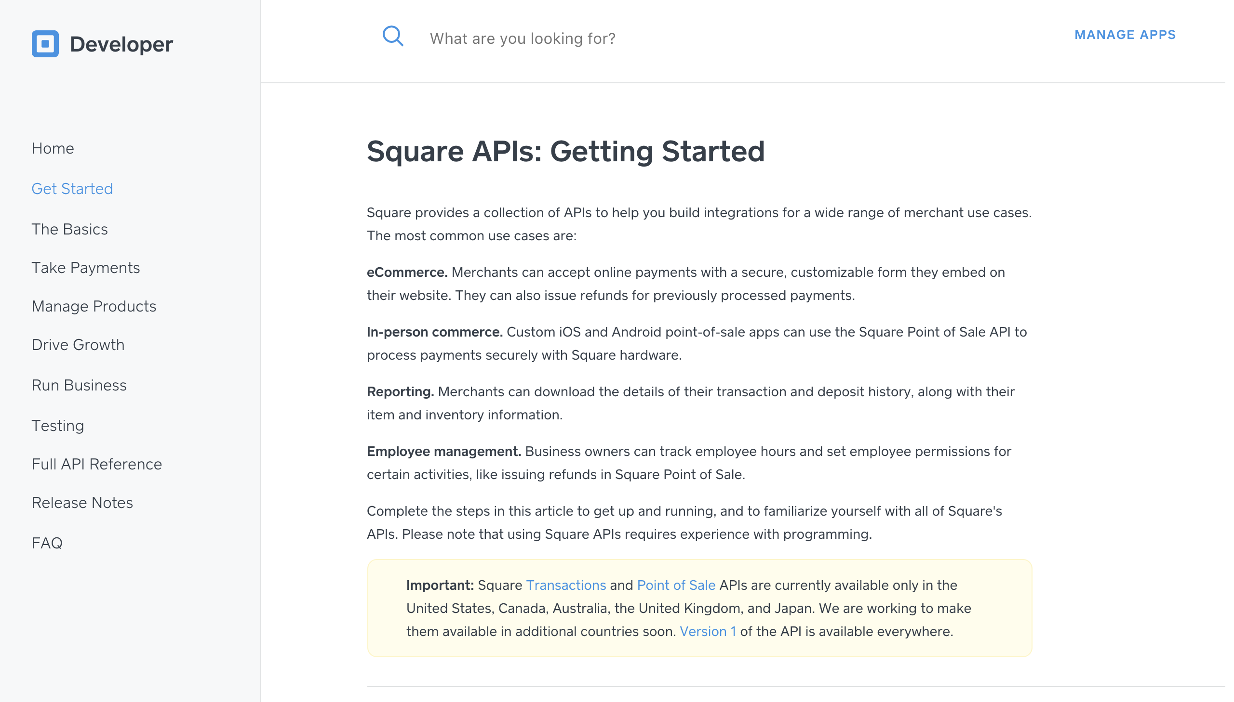
Notes:
Landing page: https://docs.connect.squareup.com/
Doc site – CONTENT
Things I like:
Language is casual, clear, and succinct. Maintains tone throughout documents.
Active voice is used consistently throughout.
The "Get started" section provides several examples of common use cases for the APIs.
The "Get started page" provides a clear, easy process to follow.
References to exploring the APIs through Postman are prevalent.
A concise choice model is provided at the end of most overviews allowing users to choose from ready-made partner solutions and the various APIs that allow them to create a custom app. Example: Drive Growth overview for Customers API, Manage Products overview for Catalog and Orders APIs

Slide 8
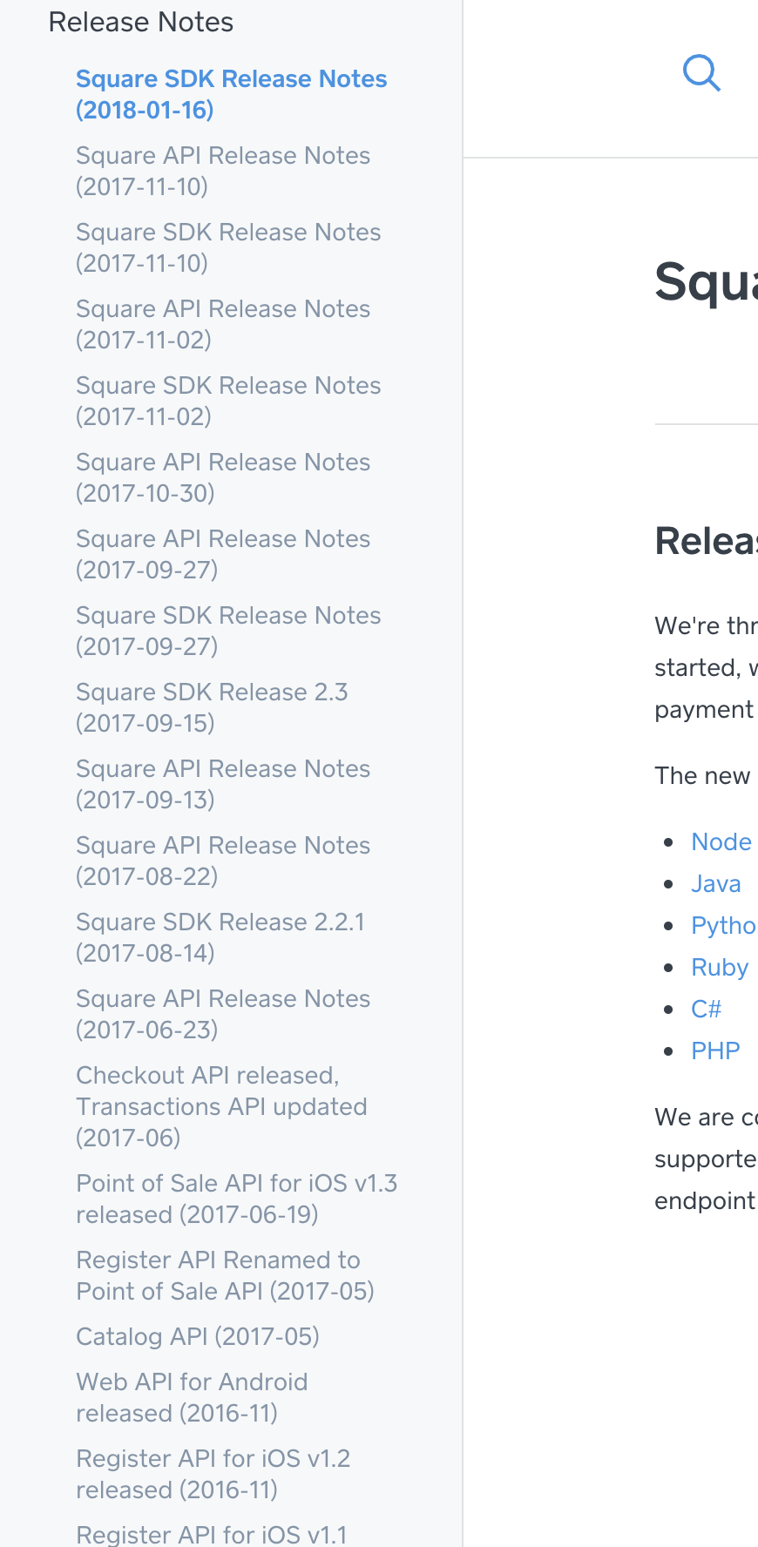
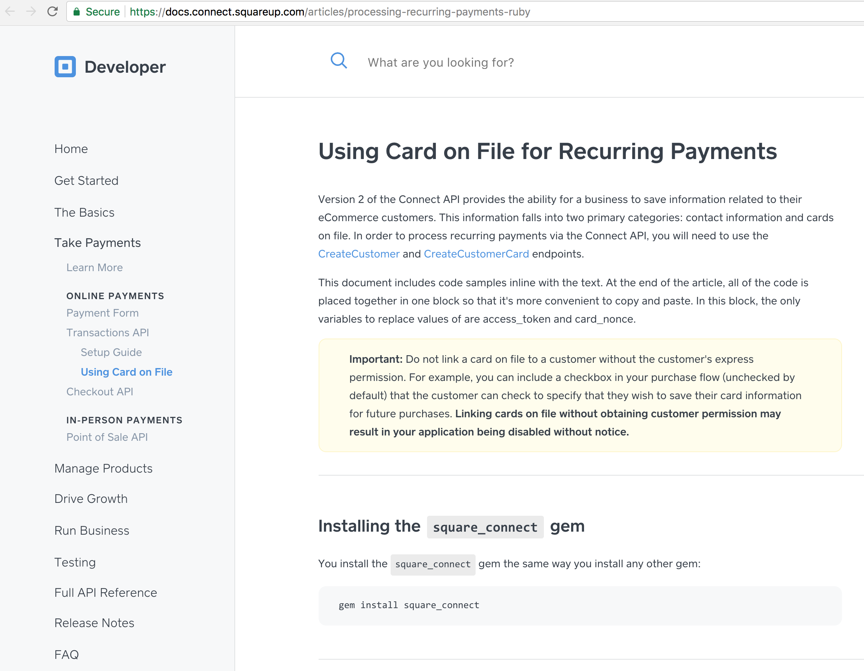
Different header
Unclear coding language
Long list in ToC
Notes:
Landing page: https://docs.connect.squareup.com/
Doc site – CONTENT
Things to change:
Clarify some of the ambiguous high-level areas in the left side ToC.
Rename "Drive Growth" to Customers since the section is for the Customer API.
"Run Business" is a broader area, encompassing Locations, Employees, Roles, and Timecards. Add the four areas as lower-level ToC items underneath Run Business so users can quickly get a feel for the areas included.
There are too many links nested under Release Notes. Group them and create another level of nesting.
Promote the sandbox environment in the getting started section/page for those who want to try some basic functionality before signing up. Make the credentials (Access Token, Application ID, and Location ID) more evident in this section, rather than only listing them in the API docs.
Describe links to GitHub with text (at GitHub) or something similar so the user knows they're leaving the docs site.
Make it a standard convention for longer docs to have ToCs at the beginning to clarify expectations for the reader. SqPaymentForm Overview and SqPaymentForm Setup don't have ToCs, but the Checkout API Setup Guide does.
Verify consistent styles are used throughout. Examples of inconsistencies are found in Note statements and code properties.
Verify consistent titles are used throughout. Example: it's unclear that this page is for Ruby, other than in the URL: https://docs.connect.squareup.com/articles/processing-recurring-payments-ruby.
Best practices:
Setting clear expectations for the reader (with the ToC).
Consistency in styling, language, and tone.

Slide 9
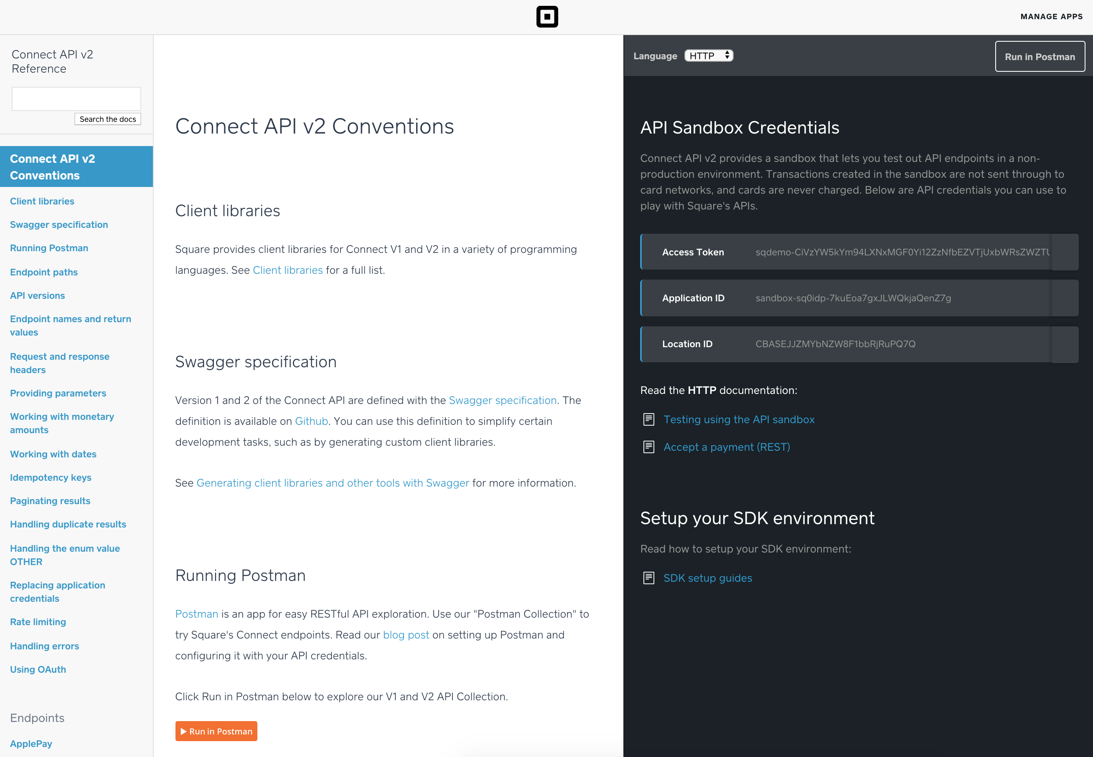
Notes:
Landing page: https://docs.connect.squareup.com/api/connect/v2
Doc site – API references
These are standard in their design, most likely auto-generated by a tool used to document API code (like Swagger or ReDoc).
Things I like:
Having the code samples immediately to the right improves accessibility and context for users.
Ability to choose the language of the sample code from several popular ones improves usability.
"Run in Postman" is easily accessible in several locations.
The Connect V1 and V2 docs begin with a description of the conventions used, providing a good overview of how to use them and what to expect
Things to change:
Yet another different header than the other areas.
When viewed on mobile devices (iPhone), the code samples aren't visible nor are you able to zoom in to make the text larger.
ToCs are really long. Make them expandable, like the docs main page, or create a ToC at the beginning/top of the long page for an overview.
Add a link to Connect V2 from Connect V1 since it says that V2 is now available, but doesn't link to them.
Have the left side ToC scroll up/down with the main content, to provide context to the user.
Best practices:

